Slide 1
Subset Analysis
(only including progression samples)

Slide 2
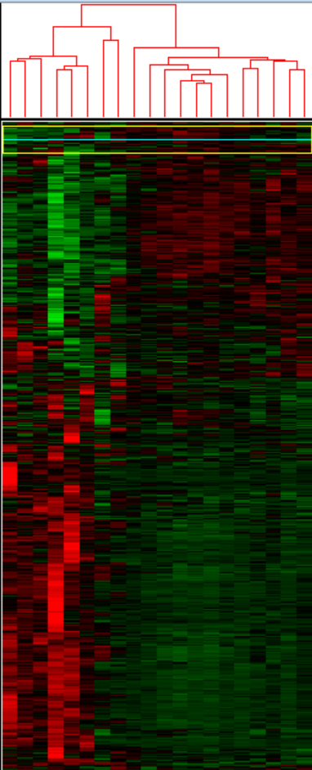
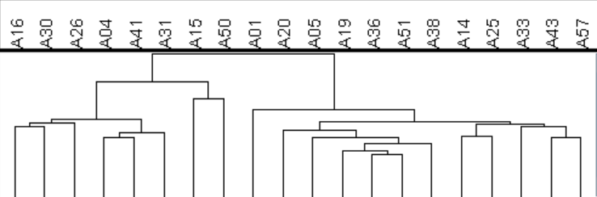
Time 1 Clustering
Subset 1
Subset 2

Slide 3
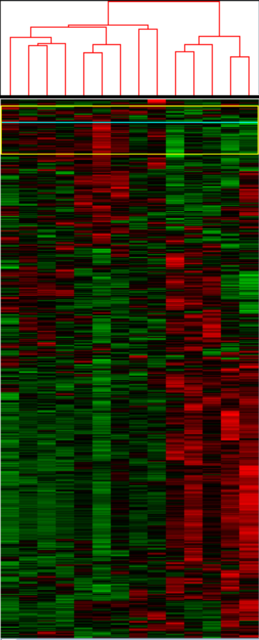
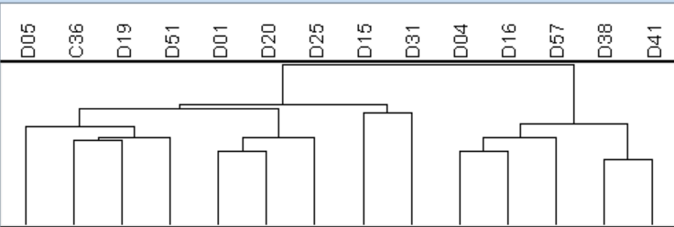
Time 3 Clustering
Subset 2
Subset 1

Slide 4
Subsets
Subset 1
A04 D04
A15* ---
A16 D16
A26
A30
A31 ---
--- D38
A41 D41
A50
--- D57
*No data at Time 2
Subset 2
A01 D01
A05 D05
A14
--- D15*
A19 D19
A20 D20
A25 D25
--- D31
A33
A36 C36
A38 ---
A43
A51 D51
A57 ---

Slide 5
DESeq2 Analysis by Subsets

Slide 6
Time 1 vs Time 2 by Subset (excluding samples w/o Time 3 data)
Subset 1
(04, 16, 31, 41)
out of 23427 with nonzero total read count
adjusted p-value < 0.1
LFC > 0 (up) : 849, 3.6%
LFC < 0 (down) : 1817, 7.8%
outliers [1] : 0, 0%
low counts [2] : 1363, 5.8%
(mean count < 9)
Subset 2
(01, 05, 19, 20, 25, 36, 38, 51, 57)
out of 23432 with nonzero total read count
adjusted p-value < 0.1
LFC > 0 (up) : 230, 0.98%
LFC < 0 (down) : 456, 1.9%
outliers [1] : 0, 0%
low counts [2] : 12266, 52%
(mean count < 196)

Slide 7
Venn Diagram of Sig. Genes

Slide 8
Time 1 vs Time 2 by Subset (including samples w/o Time 3 data)
Subset 1
(04, 16, 31, 41, 26, 30, 50)
out of 23433 with nonzero total read count
adjusted p-value < 0.1
LFC > 0 (up) : 2278, 9.7%
LFC < 0 (down) : 3367, 14%
outliers [1] : 0, 0%
low counts [2] : 0, 0%
(mean count < 0)
Subset 2
(01, 05, 19, 20, 25, 36, 38, 51, 57, 14, 33, 43)
out of 23432 with nonzero total read count
adjusted p-value < 0.1
LFC > 0 (up) : 606, 2.6%
LFC < 0 (down) : 897, 3.8%
outliers [1] : 0, 0%
low counts [2] : 6815, 29%
(mean count < 72)

Slide 9
Venn Diagram of Sig. Genes

Slide 10
Time 2 vs Time 3
Subset 1
(04, 16, 38, 41, 57)
out of 23428 with nonzero total read count
adjusted p-value < 0.1
LFC > 0 (up) : 5, 0.021%
LFC < 0 (down) : 0, 0%
outliers [1] : 0, 0%
low counts [2] : 0, 0%
(mean count < 0)
Subset 2
(01, 05, 19, 20, 25, 31, 36, 51)
out of 23433 with nonzero total read count
adjusted p-value < 0.1
LFC > 0 (up) : 111, 0.47%
LFC < 0 (down) : 378, 1.6%
outliers [1] : 0, 0%
low counts [2] : 6815, 29%
(mean count < 71)

